Slide 1

6th Grade Accelerated Math
Unit 1, Lesson 5 Dividing Multi-Digit Numbers with Decimals to the Thousandths Volume 1, pg. 26

Slide 2


Benchmark
MA.6.NSO.2.1
Multiply and divide positive multi-digit numbers with decimals to the thousandths, including using a standard algorithm with procedural fluency.
volume 1, pg. 26

Slide 3
Integrated Mathematical Thinking and Reasoning Standards
MA.K12.MTR.3.1 Complete tasks with mathematical fluency.
MA.K12.MTR.5.1 Use patterns and structure to help understand and connect mathematical concepts.
volume 1, pg. 26

Slide 4

Learning Target
I can fluently divide multi-digit numbers with decimals to the thousandths.
volume 1, pg. 26

Slide 5

Warm-Up
volume 1, pg. 26

Slide 6
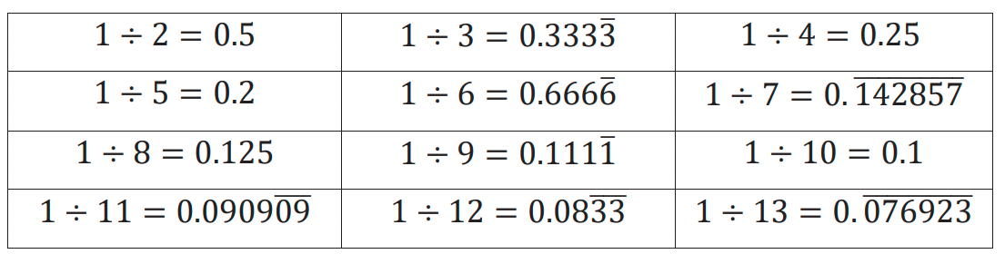
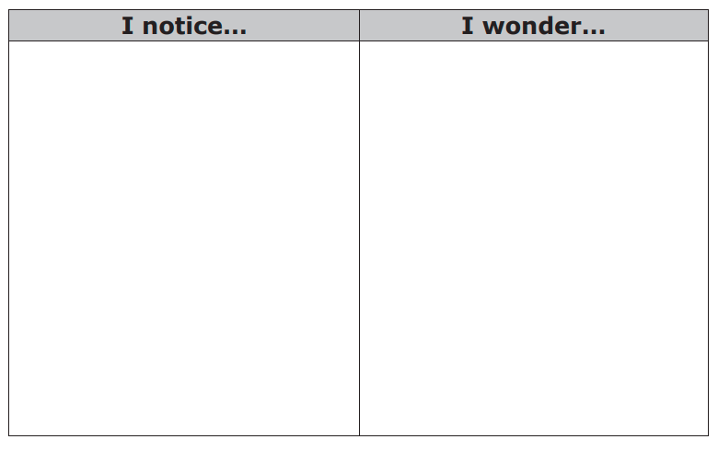
1.5.1 Warm-Up: Quotients as Decimals
The quotients of several division expressions are shown.
Write something you notice about the values of the quotients and something you still wonder.
volume 1, pg. 26

Slide 7

Refresher
volume 1, pg. 27

Slide 8

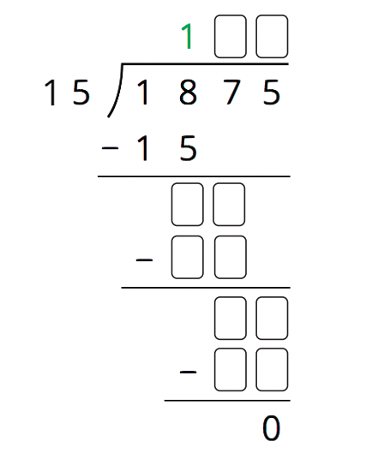
1.5.2 Refresher: Long Division
Jiang was dividing using long division and got stuck.
Complete the problem to show Jiang the missing steps.
2. What advice about long division do you have that could help Jiang in the future?
volume 1, pg. 27

Slide 9

Exploration
volume 1, pg. 27

Slide 10

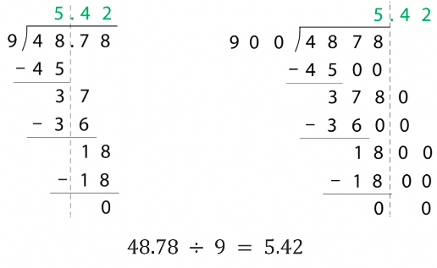
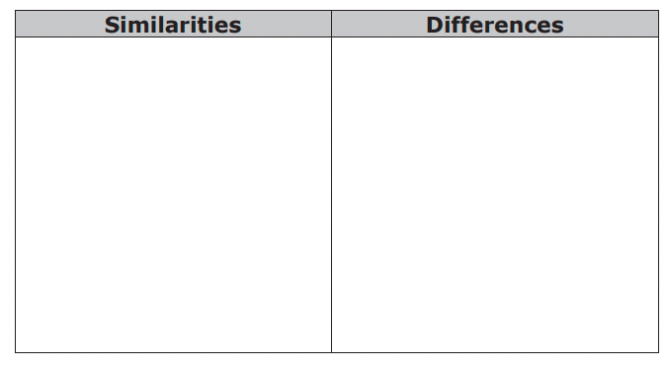
1.5.3 Exploration: Dividing Decimals
Giovanny and Alina used different strategies to find the quotient of 48.78 ÷ 9.
Giovanny’s Strategy
Alina’s Strategy
Work with your partner to answer the questions about Giovanny and Alina’s strategies.
How are the two students’ calculations alike and different?
volume 1, pg. 27

Slide 11
2. Look at Giovanny’s calculations. Complete the statements with the appropriate place value to explain how you can tell that the 36 means “36 tenths” and the 18 means “18 hundredths” in his calculations.
● The 3 in 36 is in the ____________ place and the 6 is in the ____________ place, so 36 in this calculation means 36 tenths.
● The 1 in 18 is in the ____________ place, so it has the same value as 10 hundredths. The 8 is in the ____________ place. Together, they make 18 hundredths.
3. Look at Alina’s calculations. Complete the statement to describe the values of 3600 and 1800 in her calculation.
● In Alina’s calculations, the 3600 represents 3600 ____________, and the 1800 represents 1800 ____________.
volume 1, pg. 28

Slide 12
4. Why is the value of 48.78 ÷ 9 the same as the value of 4878 ÷ 900?
5. Explain why 51.84 ÷ 6.4 has the same value as 518.4 ÷ 64.
6. Find the value of 51.84 ÷ 6.4 using long division. Show your work.
volume 1, pg. 28

Slide 13

Bring It Together
volume 1, pg. 28

Slide 14

1.5.4 Bring It Together: Dividing Decimals
Complete the summary of the exploration of dividing decimals using the words and phrases from the bank below.
does not change
multiply
power of 10
whole numbers
One way to find a quotient of two decimals is to first _______________ each decimal by a _______________ so that both values are _______________. If we multiply both values by the same power of 10, this _______________ the value of the quotient.
volume 1, pg. 28

Slide 15

Guided Practice
volume 1, pg. 29

Slide 16

1.5.5 Guided Practice: Dividing Decimals
Find each quotient using a strategy similar to Giovanny’s or Alina’s. Show your work.
a. 24.2 ÷ 1.1
b. 17.028 ÷ 0.08
volume 1, pg. 29

Slide 17
2. Coby and Olivia each found the quotient of 10.92 ÷ 2.6. The values they each used are listed.
● Coby calculated 1092 ÷ 260.
● Olivia calculated 109.2 ÷ 26.
a. Will the values they used result in the same quotient as 10.92 ÷ 2.6? Explain.
b. Find the quotient of 10.92 ÷ 2.6.
volume 1, pg. 29

Slide 18

Your Turn
volume 1, pg. 29

Slide 19
1.5.6 Your Turn!
1. Find each quotient. Show your work.
a. 43.396 ÷ 57.1
b. 29.88 ÷ 0.36
c. 262.5 ÷ 5.25
d. 15.129 ÷ 12.3
volume 1, pg. 29

Slide 20

Wrap-Up
volume 1, pg. 30

Slide 21
1.5.7 Wrap-Up: Reflection
1. Draw an X on the line to indicate where your current learning is in relation to the learning target.
I can fluently divide multi-digit numbers with decimals to the thousandths.
I need help. I can’t get started.
I’m getting there.
I understand and have evidence.
2. Briefly explain why you placed the X where you did.
volume 1, pg. 30

